Slide 1

Input/Output

Slide 2
I/O Streams and Standard I/O Devices
To use cin and cout, every C++ program must use the preprocessor directive:
#include<iostream>
Input stream: sequence of characters from an input device to the computer
Output stream: sequence of characters from the computer to an output device

Slide 3
I/O Streams and Standard I/O Devices
Use iostream header file to receive data from keyboard and send output to the screen
Contains definitions of two data types:
istream: input stream
ostream: output stream
Has two variables:
cin: stands for common input
cout: stands for common output
Variable definition is identical to C++ syntax :

Slide 4

cin and the Extraction Operator >>
The syntax of an input statement using cin and the extraction operator is >>
The extraction operator >> is binary:
cin >> variable

Slide 5
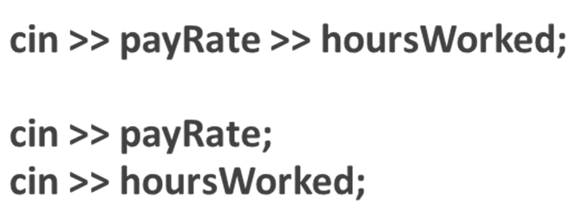
cin and the Extraction Operator >>
Following two examples are the same expressions:

Slide 6
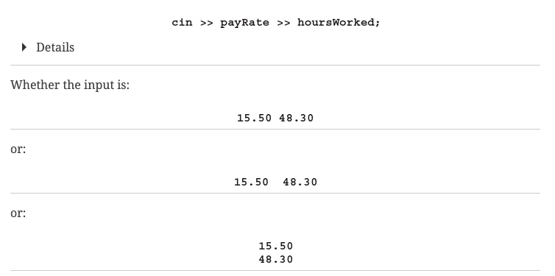
cin and the Extraction Operator >>
All expressions below are the same in terms of input entrance with different types of white spaces

Slide 7
cin and the Extraction Operator >>
Consider cin >> a
a has to be a simple data type
Data Type of a | Valid Input for a
char | One printable character except the blank.
int | An integer, possibly preceded by a + or - sign.
double | A decimal number, possibly preceded by a + or - sign. If the actual data input is an integer, the input is converted to a decimal number with the zero decimal part.

Slide 8
cin and the Extraction Operator >> Examples
https://replit.com/@btaylan/CISC3142Codes#Lecture-2/1.cpp
.
.
.
https://replit.com/@btaylan/CISC3142Codes#Lecture-2/9.cpp

Slide 9
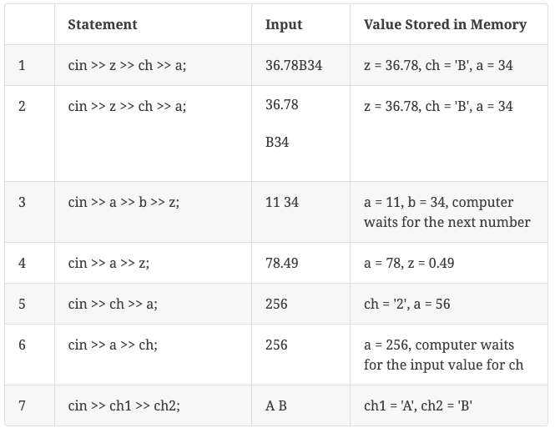

cin and the Extraction Operator >> Examples

Slide 10
Using Predefined Functions in a Program
A function (subprogram) is a set of instructions
When activated, it accomplishes a task
main executes when a program is run
Other functions execute only when called
Predefined functions are organized as a collection of libraries called header files

Slide 11
Using Predefined Functions in a Program
Header file may contain several functions
To use a predefined function, you need the name of the appropriate header file
You also need to know:
Function name
Number of parameters required
Type of each parameter
What the function is going to do

Slide 12
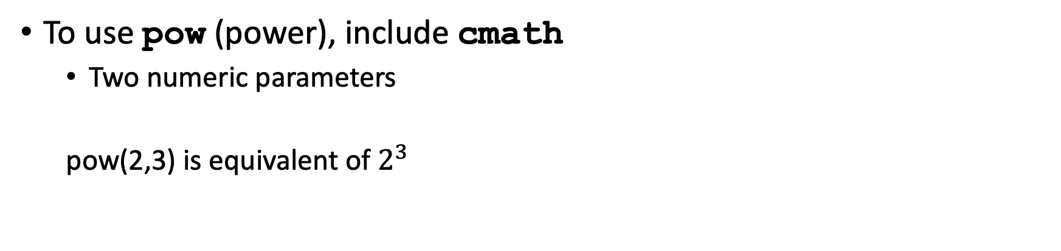
Using Predefined Functions in a Program
To use pow (power), include cmath
Two numeric parameters
pow(2,3) is equivalent of $2^{3}$
https://replit.com/@btaylan/CISC3142Codes#Lecture-2/10.cpp

Slide 13
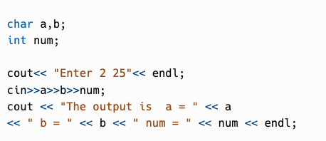
cin and <<
We want to assign
a = 2 b = ‘ ‘ num = 25
Predict the output:
https://replit.com/@btaylan/CISC3142Codes#Lecture-2/11.cpp

Slide 14

cin and the get Function
The get function
Inputs next character (including whitespace)
Stores in memory location indicated by its argument
The syntax of cin and the get function:
// varchar is any char type of variable, only char type
https://replit.com/@btaylan/CISC3142Codes#Lecture-2/12.cpp
https://replit.com/@btaylan/CISC3142Codes#Lecture-2/13.cpp

Slide 15


cin and get
Both codes are equivalent (Think about input “2 25”):

Slide 16
cin and the ignore Function
ignore function
Discards a portion of the input
cin.ignore(m, ch);
The statement says to ignore the next m characters or all characters until the character specified by ch
cin.ignore() without any parameter skips only 1 character
https://replit.com/@btaylan/CISC3142Codes#Lecture-2/14.cpp
https://replit.com/@btaylan/CISC3142Codes#Lecture-2/15.cpp

Slide 17
The putback and peek Functions
putback function
Places previous character extracted by the get function from an input stream back to that stream
cin.get(ch); //read a char and remove from stream
cin.putback(ch); //the char read in previous line is put back
peek function
Reads a char but doesn’t remove from stream
ch = cin.peek(); //read a char and don’t remove from stream
cout << ch << endl; //prints a char
cin.get(ch); //read a char and remove from stream
cout<< ch << endl; //prints the same char
https://replit.com/@btaylan/CISC3142Codes#Lecture-2/16.cpp

Slide 18
Input Failure
If input data does not match corresponding variables, the program may run into problems
int a,b;
cin>> a >> b ;
If an error occurs when reading data input stream enters the fail state
After fail state, all further I/O statements using that stream are ignored.
The program continues to execute with whatever values are stored in variables and produces incorrect results.
https://replit.com/@btaylan/CISC3142Codes#Lecture-2/17.cpp

Slide 19
The clear Function
Once in a fail state, all further I/O statements using that stream are ignored
The program continues to execute with whatever values are stored in variables
This causes incorrect results
The clear function restores the input stream to a working state
The syntax of the function clear is:
cin.clear() ;
https://replit.com/@btaylan/CISC3142Codes#Lecture-2/18.cpp

Slide 20
Output and Formatting Output
Syntax of cout when used with <<
expression is evaluated
manipulator is used to format the output
Example: endl

Slide 21

setprecision Manipulator
Syntax: setprecision(n) used with cout
Outputs total number of digits up to (n) digit
Must include the header file iomanip
#include <iomanip>
fixed outputs floating-point numbers in a fixed decimal format
Disable by using the stream member function unsetf
https://replit.com/@btaylan/CISC3142Codes#Lecture-2/19.cpp

Slide 22
showpoint Manipulator
showpoint forces output to show the decimal point and trailing zeros
https://replit.com/@btaylan/CISC3142Codes#Lecture-2/20.cpp

Slide 23
setw
Outputs the value of an expression in a specified number of columns
If number of columns exceeds n in setw(n), then the output is right-justified
Unused columns to the left are filled with spaces
setfill(ch) : unused columns are set by a specific character ch
Must include the header file iomanip
C++ scientific notation
cout<< scientific << 12.345 << endl;
Left and right justified text :
cout<< setw(12) << left << "Hello!" <<endl;
cout<< setw(12)<< right << "Hello!" <<endl;
https://replit.com/@btaylan/CISC3142Codes#Lecture-2/21.cpp

Slide 24
Input/Output and the string Type
Using cin and string together might create a problem if string contains space
- The extraction operator:
Skips any leading whitespace characters
Stops reading at a whitespace character
The function getline reads until end of the current line
https://replit.com/@btaylan/CISC3142Codes#Lecture-2/22.cpp

Slide 25
File Stream
#include<fstream> header file is required
Input and output variables can be created just like cin and cout as follows:
ifstream input;
ofstream output;
Open the source and the destination files:
input.open("1.txt"); //source file to read from
output.open("new.txt"); //destination file

Slide 26
File Stream
Assume following variables are defined:
int num;
char ch;
Read from input file into variables:
input >> num >> ch; //read from input into variables like cin
cout<<num << ch <<endl; //print the values
Write into destination file:
output << ch << num << endl;

Slide 27
File Stream
Close input and output files:
input.close(); //close open files
output.close();
https://replit.com/@btaylan/CISC3142Codes#Lecture-2/23.cpp
https://replit.com/@btaylan/CISC3142Codes#Lecture-2/24.cpp

